Slide 1

Introduction to OpenMP
Part3. Working with OpenMP
人工智能技术学院
缪青海
miaoqh@ucas.ac.cn

Slide 2
Content
Getting started with OpenMP
Core features of OpenMP
Work with OpenMP
Advanced topics on OpenMP

Slide 3
Working with OpenMP
Synchronize single masters and stuff
Data environment
Linked lists and OpenMP

Slide 4
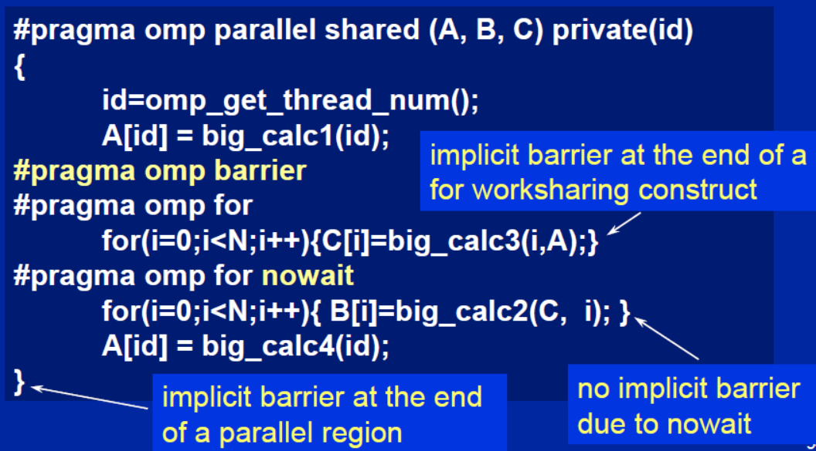
Synchronization: Barrier
Barrier: Each thread waits until all threads arrive.

Slide 5
Master Construct
The master construct denotes a structured block that is only executed by the master thread.
The other threads just skip it (no synchronization is implied).
#pragma omp parallel
{
  do_many_things();
  #pragma omp master
  { exchange_boundaries(); }
  #pragma omp barrier
  do_many_other_things();
}

Slide 6
Single Construct
The single construct denotes a block of code that is executed by only one thread (not necessarily the master thread).
A barrier is implied at the end of the single block (can remove the barrier with a nowait clause).
#pragma omp parallel
{
  do_many_things();
  #pragma omp single
  { exchange_boundaries(); }
  do_many_other_things();
}

Slide 7
Sections Construct
The Sections worksharing construct gives a different structured block to each thread.
By default, there is a barrier at the end of the “omp sections”. Use the “nowait” clause to turn off the barrier.
#pragma omp parallel
{
  #pragma omp sections
  {
  #pragma omp section
    x_calculation();
  #pragma omp section
    y_calculation();
  #pragma omp section
    z_calculation();
  }
}

Slide 8
Synchronization: Lock routines
A lock implies a memory fence (a “flush”) of all thread visible variables.
Simple Lock:
  A simple lock is available if it is unset.
  –omp_init_lock(), omp_set_lock(), omp_unset_lock(), omp_test_lock(), omp_destroy_lock()
Nested Locks:

Slide 9
Synchronization: Lock routines
A lock implies a memory fence (a “flush”) of all thread visible variables.
Simple Lock:
Nested Locks:
  A nested lock is available if it is unset or if it is set but owned by the thread executing the nested lock function
  –omp_init_nest_lock(), omp_set_nest_lock(), omp_unset_nest_lock(), omp_test_nest_lock(), omp_destroy_nest_lock()

Slide 10
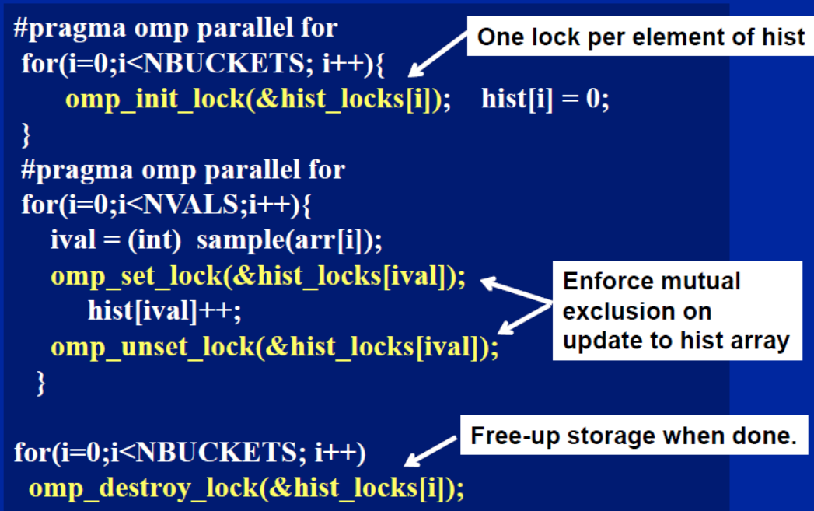
Synchronization: Simple Lock

Slide 11
Runtime Library routines
Runtime environment routines:
  Modify/Check the number of threads
    omp_set_num_threads(), omp_get_num_threads(), omp_get_thread_num(), omp_get_max_threads()
  Are we in an active parallel region?
    omp_in_parallel()
  Do you want the system to dynamically vary the number of threads from one parallel construct to another?
    omp_set_dynamic(), omp_get_dynamic()
  How many processors in the system?
    omp_num_procs()

Slide 12
Runtime Library routines
Use fixed number of threads in a program:
#include <omp.h>
void main()
{ int num_threads;
  omp_set_dynamic( 0 );
  omp_set_num_threads( omp_num_procs() );
  #pragma omp parallel
  { int id=omp_get_thread_num();
  #pragma omp single
    num_threads = omp_get_num_threads();
    do_lots_of_stuff(id);
  }
}

Slide 13
Environment Variables
Set the default number of threads to use.
  –OMP_NUM_THREADS int_literal
OpenMP added an environment variable to control the size of child threads’ stack
  –OMP_STACKSIZE
Also added an environment variable to hint to runtime how to treat idle threads
  –OMP_WAIT_POLICY
    – ACTIVE keep threads alive at barriers/locks
    – PASSIVE try to release processor at barriers/locks

Slide 14
Working with OpenMP
Synchronize single masters and stuff
Data environment
Linked lists and OpenMP

Slide 15
Data environment
Default storage attributes:
  Shared Memory programming model:
    Most variables are shared by default
  Global variables are SHARED among threads:
    File scope variables, static
    dynamically allocated memory (ALLOCATE, malloc, new)
    But not everything is shared...
    Stack variables in functions(C) called from parallel regions are PRIVATE
    Automatic variables within a statement block are PRIVATE.

Slide 16
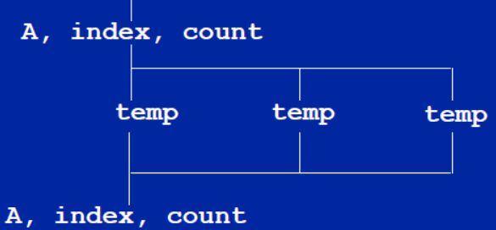
Data environment: example
double A[10];
int main() {
  int index[10];
  #pragma omp parallel
  work(index);
  printf(“%d\n”, index[0]);;
}
extern double A[10];
void work(int *index) {
  double temp[10];
  static int count;
  ...
}
A, index and count are shared by all threads.
temp is local to each thread

Slide 17
Changing storage attributes
One can selectively change storage attributes for constructs using the following clauses:
    – SHARED
    – PRIVATE
    – FIRSTPRIVATE
The final value of a private inside a parallel loop can be transmitted to the shared variable outside the loop with:
    – LASTPRIVATE
The default attributes can be overridden with:
    – DEFAULT (SHARED | NONE)

Slide 18
Data Sharing: Private Clause
private(var)
  creates a new local copy of var for each thread.
  – The value of the private copies is uninitialized
  – The value of the original variable is unchanged after the region
void wrong() {
int tmp = 0;
#pragma omp parallel for private(tmp)
  for (int j = 0; j < 1000; ++j)
  tmp += j;
  printf(“%d\n”, tmp);
}

Slide 19
Data Sharing: Firstprivate Clause
firstprivate(var)
  Variables initialized from shared variable
  C++ objects are copy-constructed
incr = 0;
#pragma omp parallel for firstprivate(incr)
for (i = 0; i <= MAX; i++) {
  if ((i%2)==0) incr++;
  A[i] = incr;
}
Each thread gets its own copy
of incr with an initial value of 0

Slide 20
Data Sharing: Lastprivate Clause
lastprivate(var)
  Variables update shared variable using value from last iteration
  C++ objects are updated as if by assignment
void sq2(int n, double *lastterm) {
  double x; int i;
  #pragma omp parallel for lastprivate(x)
    for (i = 0; i < n; i++){
    x = a[i]*a[i] + b[i]*b[i];
    b[i] = sqrt(x);
    }
  *lastterm = x;
}
“x” has the value it held
for the “last sequential”
iteration (i.e., for i=(n-1))

Slide 21

Data Sharing: A Test
Are A,B,C local to each thread or shared inside the parallel region?
What are their initial values inside and values after the parallel region?

Slide 22
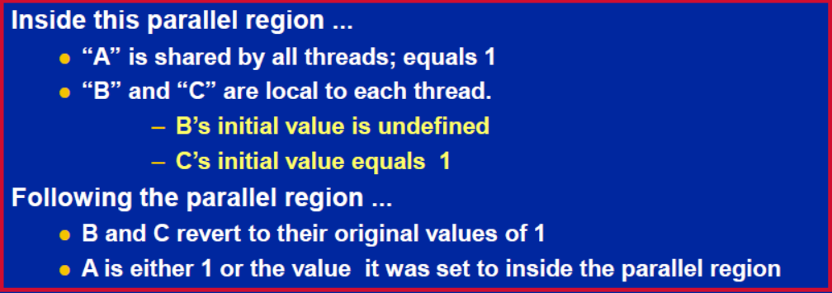
Data Sharing: A Test
Are A,B,C local to each thread or shared inside the parallel region?
What are their initial values inside and values after the parallel region?

Slide 23
Data Sharing: Default Clause
DEFAULT(SHARED)
  Note this is the default storage attribute
  Exception: #pragma omp task
DEFAULT(PRIVATE)
  To change default to PRIVATE
  each variable in the construct is made private as if specified in a private clause
DEFAULT(NONE):
  no default for variables in static extent. Must list storage attribute for each variable in static extent.
  Good programming practice!

Slide 24
Example: Serial PI Program
  static long num_steps = 100000;
  double step;
  int main ()
  {
  int i; double x, pi, sum = 0.0;
  step = 1.0/(double) num_steps;
  for (i=0;i< num_steps; i++){
  x = (i+0.5)*step;
  sum = sum + 4.0/(1.0+x*x);
  }
  pi = step * sum;
  }

Slide 25
Example: PI Program minimal changes
  #include <omp.h>
  static long num_steps = 100000; double step;
  int main ()
  {
  int i; double x, pi, sum = 0.0;
  step = 1.0/(double) num_steps;
  #pragma omp parallel for private(x) reduction(+:sum)
  for (i=0;i< num_steps; i++){
  x = (i+0.5)*step;
  sum = sum + 4.0/(1.0+x*x);
  }
  pi = step * sum;
  }

Slide 26
Working with OpenMP
Synchronize single masters and stuff
Data environment
Linked lists and OpenMP

Slide 27
Review
To create a team of threads
  􀂋 #pragma omp parallel
To share work between threads:
  􀂋 #pragma omp for
  􀂋 #pragma omp single
To prevent conflicts (prevent races)
  􀂋 #pragma omp critical
  􀂋 #pragma omp atomic
  􀂋 #pragma omp barrier
  􀂋 #pragma omp master

Slide 28
Review
Data environment clauses
  􀂋 private (variable_list)
  􀂋 firstprivate (variable_list)
  􀂋 lastprivate (variable_list)
  􀂋 reduction(+:variable_list)
Where variable_list is a comma separated list of variables.

Slide 29
simple list traversal
Given what we’ve covered about OpenMP, how would you process this loop in Parallel?
the loop worksharing construct only works with loops for
The while loops are not covered
  p=head;
  while (p) {
    process(p);
    p = p->next;
  }

Slide 30
Test2：linked lists the hard way
Consider the program linked.c
  Traverses a linked list computing a sequence of Fibonacci numbers at each node.
Parallelize this program using constructs described so far.
Once you have a correct program, optimize it.
Code: test2_Fibonacci/linked.c

Slide 31
list traversal
When OpenMP was first created, it focused on common use cases in HPC … Fortran arrays processed over “regular” loops.
Recursion and “pointer chasing” were removed from the Fortan focus.
Hence, even a simple list traversal is exceedingly difficult with the original versions of OpenMP.

Slide 32
Test2-1: Linked lists omp25
while (p != NULL) {
  p = p->next;
  count++;
}
p = head;
for(i=0; i<count; i++) {
  parr[i] = p;
  p = p->next;
}
#pragma omp parallel
{
  #pragma omp for schedule(static,1)
  for(i=0; i<count; i++)
  processwork(parr[i]);
}
Count number of items in the linked list
Copy pointer to each node into an array
Process nodes in parallel with a for loop
Code: test2_Fibonacci/solution/Linked_omp25.c

Slide 33
Linked lists
Using C++ STL
std::vector<node *> nodelist;
for (p = head; p != NULL; p = p->next)
nodelist.push_back(p);
int j = (int)nodelist.size();
#pragma omp parallel for schedule(static,1)
for (int i = 0; i < j; ++i)
processwork(nodelist[i]);
Count number of items in the linked list
Count number of items in the linked list
Process nodes in parallel with a for loop

Slide 34
Conclusion
We were able to parallelize the linked list traversal … but it was ugly and required multiple passes over the data.
To move beyond its roots in the array based world of scientific computing, we needed to support more general data structures and loops beyond basic for loops.
To do this, we added tasks in OpenMP 3.0

Slide 35
references
Tim Mattson, A “Hands-on” Introduction to OpenMP, Intel Corp.
Mark Bull, Parallel Programming with OpenMP, EPCC, University of Edinburgh, UK.
迟学斌等，并行计算与实现技术，科学出版社。

